Slide 1
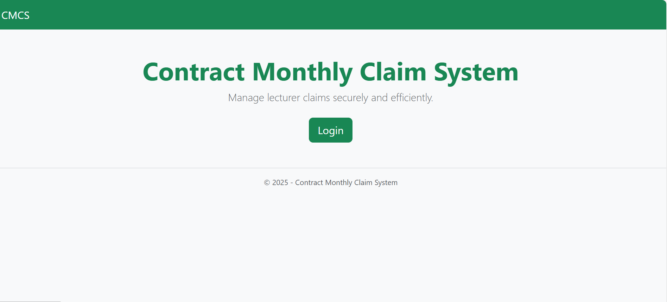
Teah Andrew ST10440926
CMCS APP

Slide 2
System Overview
Short description of what CMCS does
The Contract Monthly Claim System (CMCS) is designed to help lecturers submit monthly teaching claims quickly and securely.
HR can verify and manage lecturer claims.
Managers can approve claims and generate official PDF reports.
The system uses ASP.NET MVC, SQL Server, and secure file handling.
Why the system exists
The system was developed to streamline and secure the lecturer claim submission and approval workflow.”

Slide 3
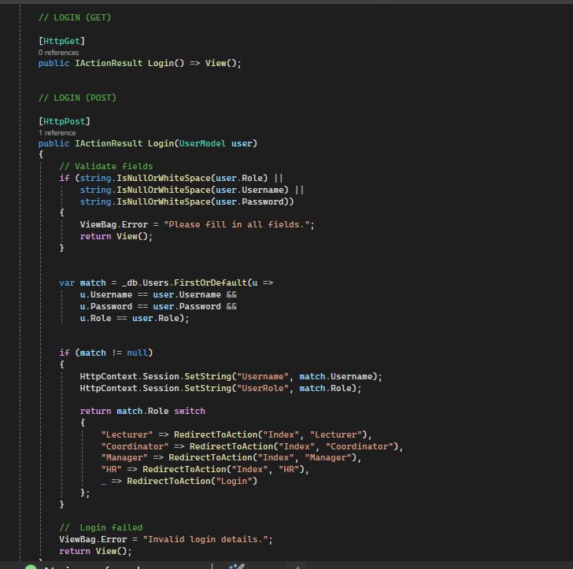
This code demonstrates the login logic for Login & Role-Based Access the CMCS application. The system validates user input, checks the database for a matching user record and confirms the selected role (Lecturer, HR, Manager, or Coordinator). If the login is successful, the system stores the username and role inside the session and redirects the user to the correct dashboard based on their role. This ensures secure authentication and strict role-based navigation, in line with the project requirements.
Login & Role-Based Access

Slide 4
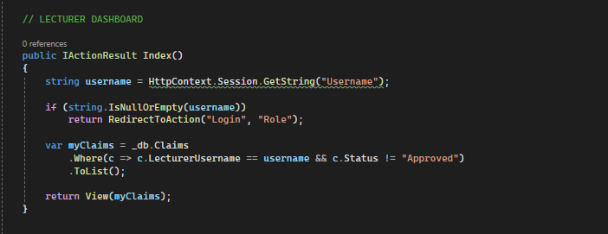
This section of the LecturerController demonstrates how the system protects dashboard access using session-based authentication. When the lecturer attempts to access the dashboard, the controller checks whether a valid username exists inside the current session
Session-Based Access Control

Slide 5
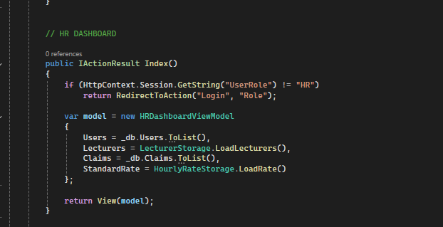
This code shows how the CMCS system restricts access to the HR dashboard using session-based role validation. Before loading the HR interface, the controller checks whether the current session contains a valid user role equal to ‘HR’. If the role does not match, the user is immediately redirected back to the login page.
This ensures that only authorized HR users can access sensitive HR functionalities such as managing users, viewing lecturer data, loading claims, and retrieving the standard hourly rate
HRController → Index() session + role check

Slide 6
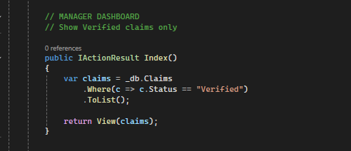
This code shows how the CMCS system restricts access to the HR dashboard using session-based role validation. Before loading the HR interface, the controller checks whether the current session contains a valid user role equal to ‘HR’. If the role does not match, the user is immediately redirected back to the login page.
This ensures that only authorized HR users can access sensitive HR functionalities such as managing users, viewing lecturer data, loading claims, and retrieving the standard hourly rate
ManagerController → Index() session + role check

Slide 7
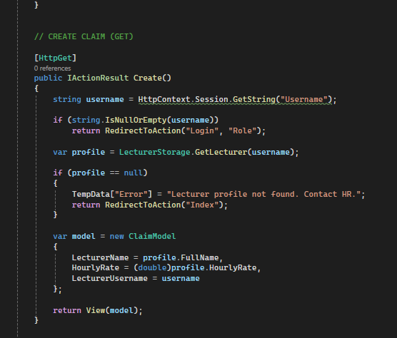
Only logged-in lecturers can open the create claim form.
Create GET method

Slide 8
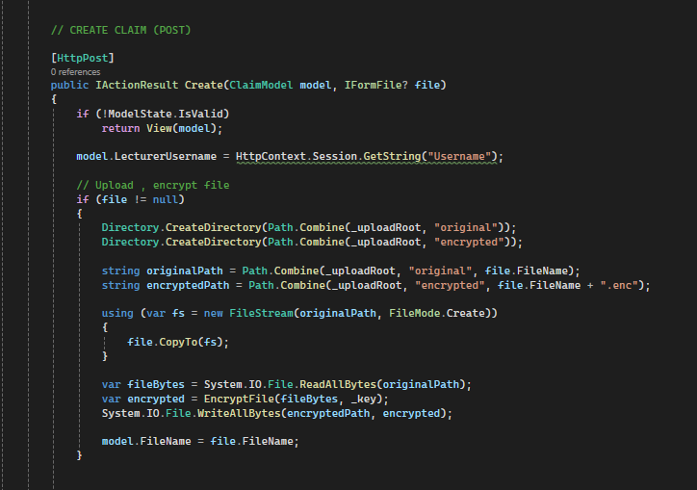
This controller method handles the lecturer’s submission of a new claim. The system first validates that the user is logged in using session checking. Once authenticated, the system validates the claim model and processes the uploaded supporting document.
The claim is then linked to the logged-in lecturer, assigned a default status of Pending, timestamped, and stored in the SQL database. This ensures that all claim submissions are authenticated, validated, and securely saved for HR verification
Create POST method

Slide 9
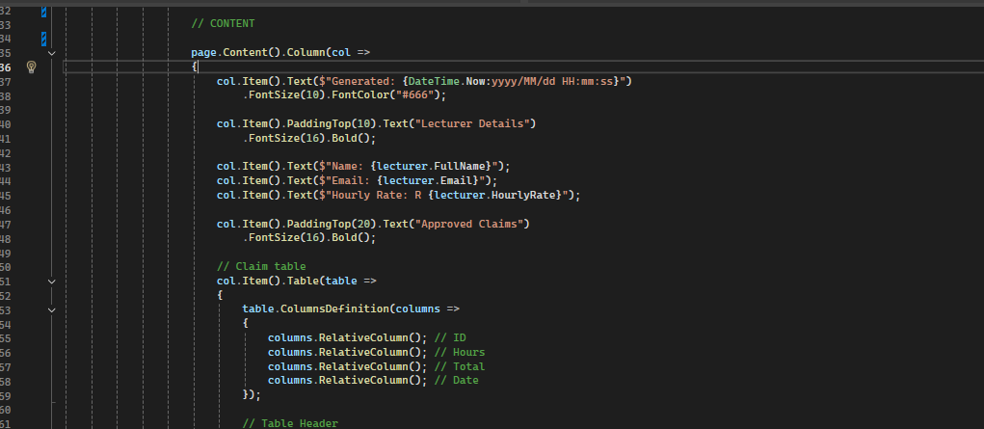
This section of the application is responsible for generating the official Contract Monthly Claim Report using the QuestPDF library. The system collects all approved claims for a selected lecturer and automatically calculates the total hours worked and the total amount payable.
The report includes a professional header, lecturer details, a formatted table of approved claims, and automatically generated totals. QuestPDF is used to build the report programmatically with defined layout components such as headers, tables, content columns, and footers.
Once the layout is complete, the method returns a fully generated PDF file, which HR and management can download for record-keeping and audit purposes
PDF Report Generation

